Slide 1
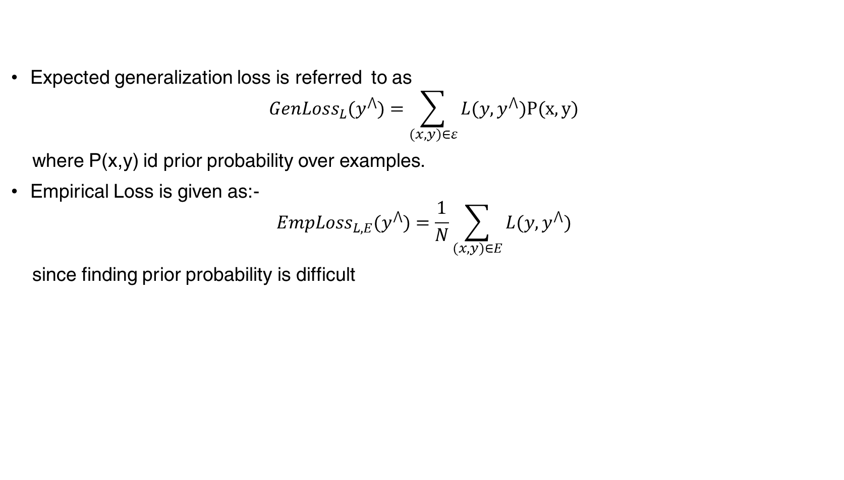
Loss Function
Expected generalization loss is referred to as
$${GenLoss}_{L}(y^{⋀})=\sum_{(x,y)∈ε}{L(y,}y^{⋀})P(x,y)$$
where P(x,y) id prior probability over examples.
Empirical Loss is given as:-
$${EmpLoss}_{L,E}(y^{⋀})=\frac{1}{N}\sum_{(x,y)∈E}{L(y,}y^{⋀})$$
since finding prior probability is difficult

Slide 2
Gradient Descent
Given any algorithm, we will try to minimize the loss function.
We will try to optimize the loss function using gradient descent

Slide 3

Evaluation Metrics
Classification Accuracy
The ratio of number of correct predictions to the total number of samples.
Ideal when there are roughly same number of samples from each class.
$$Accuracy=\frac{Number of Correct Predictions}{Total number of predictions made}$$

Slide 4
Generalization
Goal: Build a model which is accurate enough on train set and is generalizable (performs similarly) to unseen examples
Can’t keep generating nodes as it performs poorly on test sets

Slide 5
Overfitting
Model is optimized to perform well only on train set however unable to produce similar results on unseen examples, i.e., test set
To overcome overfitting in decision trees
Pruning: eliminating nodes that are clearly not relevant
Generate the full tree with Decision Tree Algorithm
Look at a node that has only leaf nodes as descendants
If the test at the node is irrelevant, i.e., fitting noise in the data, we prune the node

Slide 6
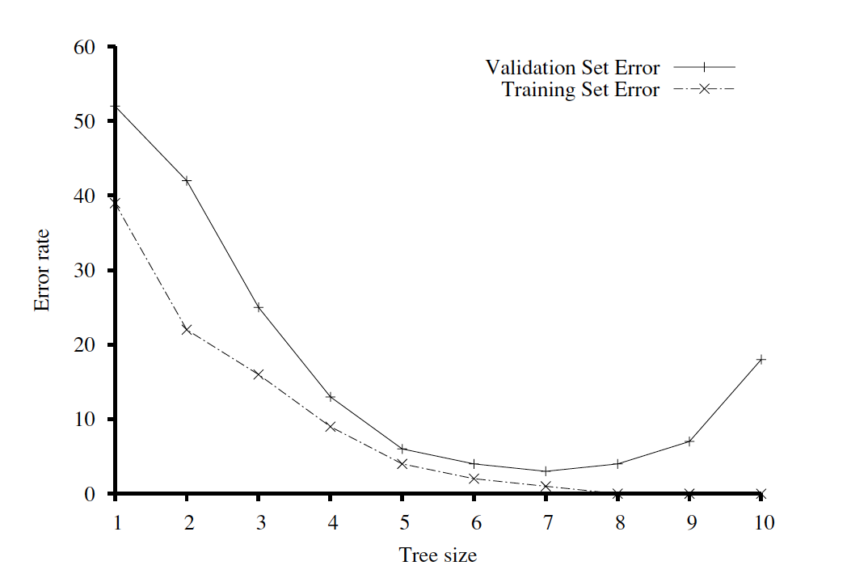
Finding Generalizable Models: Early Stopping

Slide 7
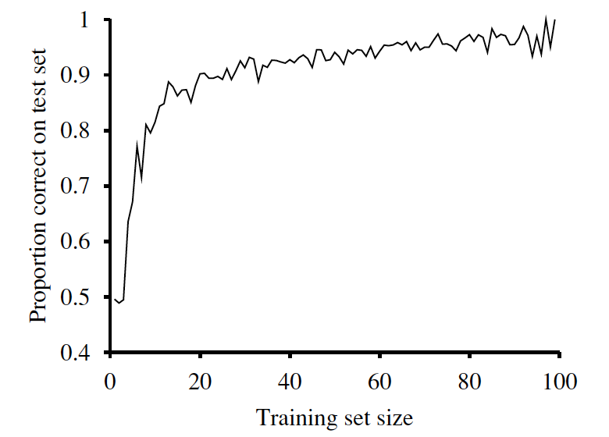
Finding Generalizable Models: More Data
Learning Curve
Take 100 training samples
Take 1 sample and learn the tree and test it on test set
Keep adding samples (by 1) and repeat the above step
Repeat the entire process by randomly shuffling training samples and take an average of test accuracies

Slide 8
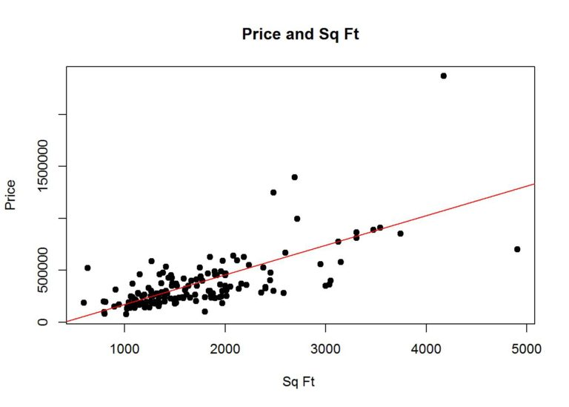
Regression
When the variable to predict (y) is continuous real valued variable
E.g., Predict the prices of houses based on the sqft of house

Slide 9

Linear Regression
Univariate Linear Regression
A linear function with input $x$ and output $h$ represented as
$${y =h}_{w}\left(x\right)=w_{1}x+w_{0}$$
Learning the weight vector $[w_{1},w_{0}]$ from the training examples that best fits the data is referred to as linear regression
E.g., Predicting house prices from sqft alone is univariate linear regression

Slide 10

Linear Regression
Multivariate Linear Regression
A natural extension of univariate linear regression is by having a weighted linear combination of multiple variables
$$y_{j}= h_{w}\left(x_{j}\right)=w_{0}+\sum_{i}{w_{i}x_{j,i}}$$
for each example $x_{j}$
E.g., Predicting house prices as a function of [sqft, location, number of bed rooms]

Slide 11

Unsupervised Learning
Attempts to extract patterns from a set of examples without any target dependent variable
Given data $𝒳$, the representation that preserves as much information about $𝒳$ as possible while keeping the representation simpler and more accessible than $𝒳$ itself

Slide 12
Clustering
To cluster examples in data that are similar to each other
Similar entities share similar attributes which means partial redundancy
By clustering similar entities and representing them as a single entity would help to disentangle the variation in data
E.g., finding groups of customers with similar behavior given the customer data with their properties and past buying records

Slide 13
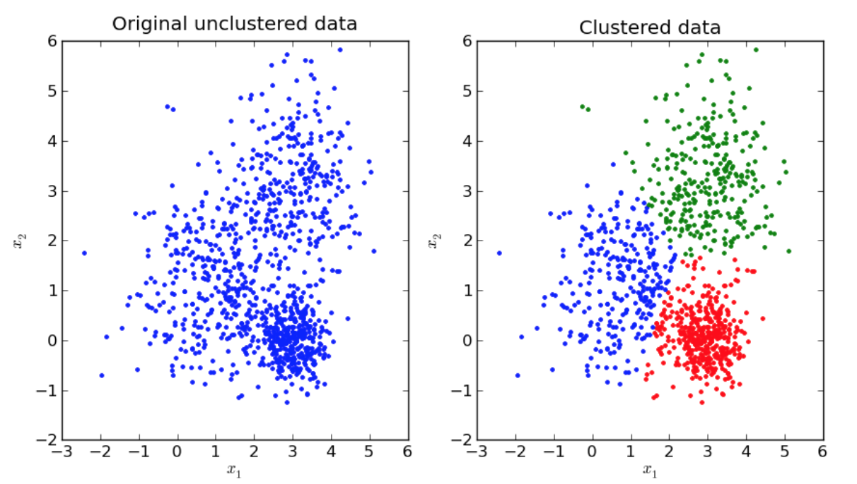
Clustering

Slide 14

K-means Clustering
K-means algorithm divides the training set into k different clusters $[μ^{\left(1\right)},μ^{\left(2\right)},…..μ^{\left(k\right)}]$ that are near to each other
K-means algorithm works by randomly initializing k different centroids to different values, then altering between 2 steps until convergence
In one step, each training example is assigned to cluster i, where i is the index of nearest centroid $μ^{\left(i\right)}$
In another step, each centroid $μ^{\left(i\right)}$ is updated to the mean of all training examples $x^{\left(j\right)}$assigned to cluster i

Slide 15
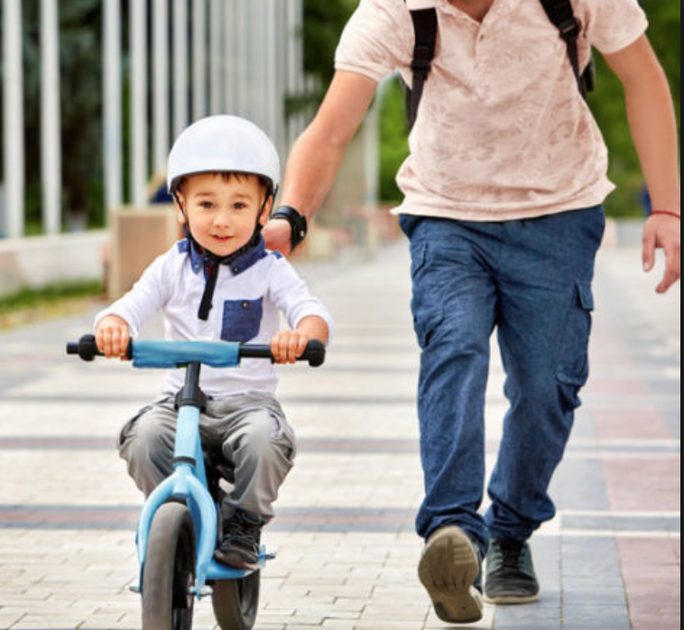
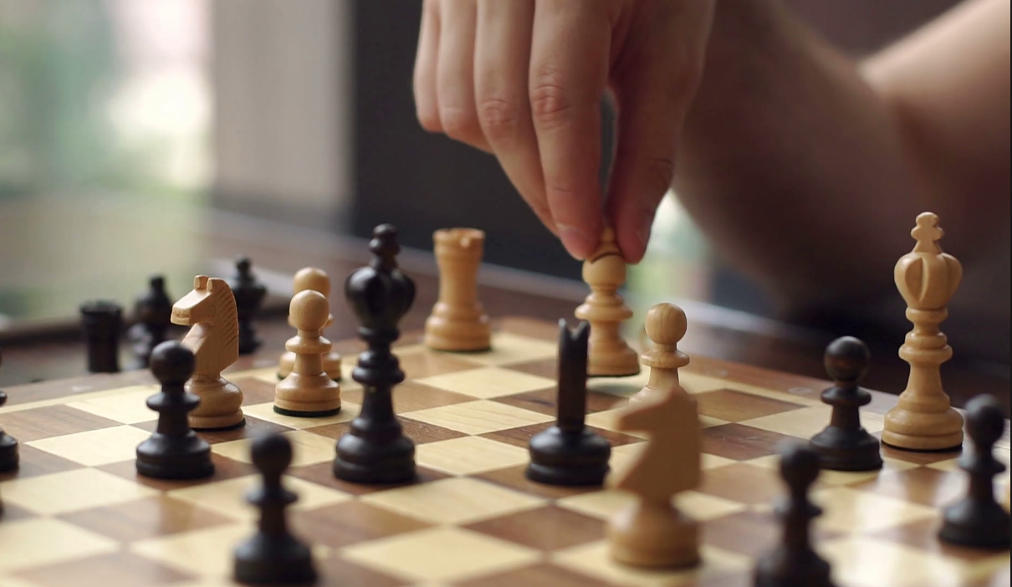
Reinforcement Learning
The frequency of rewards varies with the problem

Slide 16
Reinforcement Learning
A Policy is a function that maps inputs to actions
The goal of Reinforcement Learning – Identify an optimal policy that maximizes the expected total reward
Task: Use observed rewards to learn an optimal policy for the environment
Reinforcement Learning in nutshell: Imagine playing a new game and after 100 moves your opponent says you lost the game.

Slide 17
ML: Reinforcement Learning
Feedback / Reward (+1 / -1)
Improve Action to optimize Reward
Computer Agent
Environment
Perform Action
based on state

Slide 18

ML: Reinforcement Learning

Slide 19
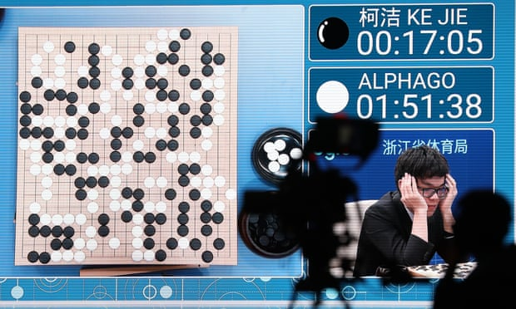
Examples of Reinforcement Learning
Alpha Go
Learning from thousands of games, AlphaGo has outplayed the famous professionals in Go game
Robotics
Robot trying to walk, cook,
pick a pen, etc
Autonomous driving
Trying to learn how to drive cars
in real-life environments

Slide 20

Agent
The agent makes the decision of what action to make
Agent is allowed to use any observation from environment and internal rules it has
At each step ‘t’ the agent:
Executes an action $A_{t}$
Receives observation $O_{t}$
Receives scalar Reward $R_{t}$

Slide 21
Components of Agent
Policy
Value Function
Model

Slide 22

Policy
Policy defines the behavior of the agent
If you are lazy, you would look for shortcuts to reach the destination soon or you may not even reach the destination if your calculations are wrong or if there are obstacles in the way
Stochastic Policy:-
For every decision you have a probability given the current state. Over experience you want to optimize this probability distribution so that you get a higher chance of success while finding shortcuts
$$Π\left(a | s\right)=P[A=a|S=s]$$

Slide 23

Policy
If you were taking the methodical approach, you would be knowing what direction to chose at any point of time
Deterministic Policy:-
a function that maps states to actions
$$a=Π\left(s\right)$$
here, ‘∏’ is just the policy function that simply gives an output state given your current state

Slide 24
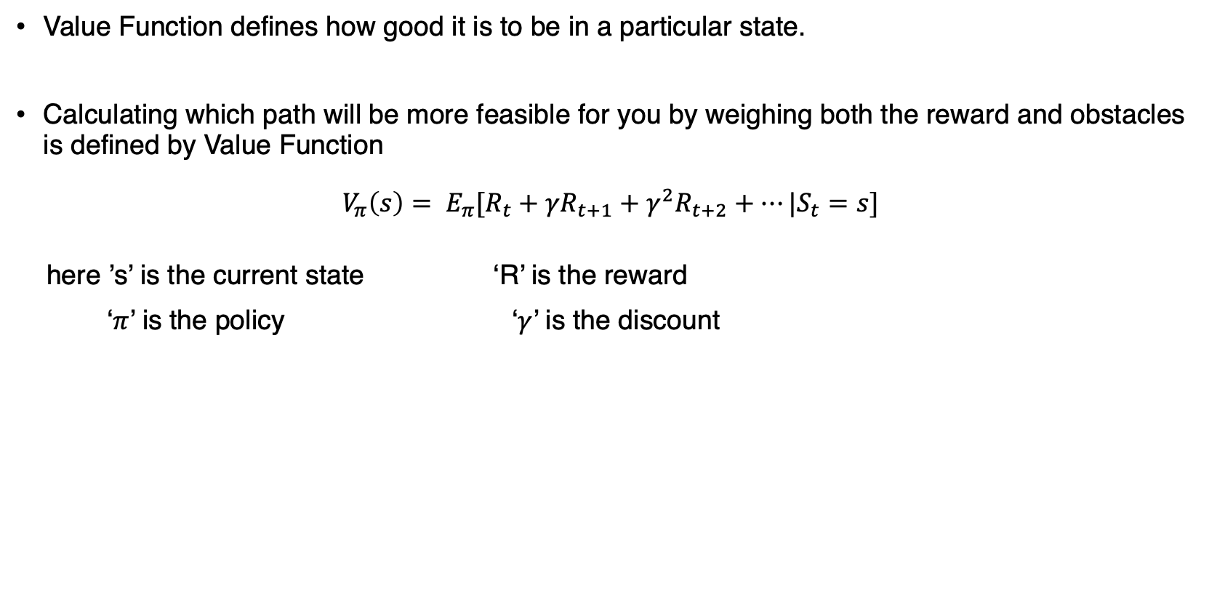
Value Function
Value Function defines how good it is to be in a particular state.
Calculating which path will be more feasible for you by weighing both the reward and obstacles is defined by Value Function
$$V_{π}\left(s\right)= E_{π}[R_{t}+γR_{t+1}+γ^{2}R_{t+2}+…|S_{t}=s]$$
here ’s’ is the current state ‘R’ is the reward
‘$π$’ is the policy ‘$γ$’ is the discount

Slide 25
Model
Model is the agent’s representation of the environment
Transition Model:
Model try to predict the dynamics of the environment with the data it has seen till that point
Reward Model:
Based on previous experiences, predicting the reward provided by environment.

Slide 26
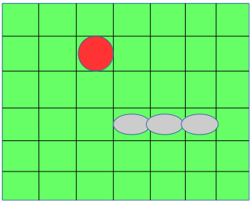
Snake Example
Instructions :
Eat apple(red circle) to get points.
Eat cherries(pink circle to get bonus points).
If you hit wall or eat yourself you die.
Controls are UP, DOWN, LEFT, RIGHT

Slide 27
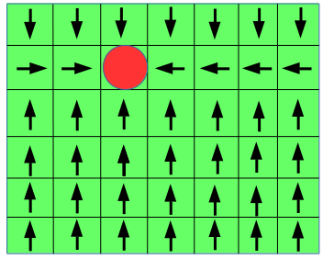
Applying Policy
Snake need to have some behavior to eat the apple

Slide 28
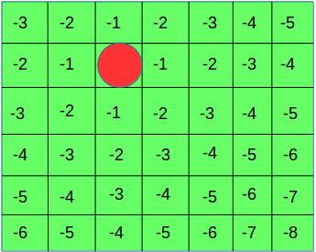
Applying Value Function
In value function we assign every grid a value

Slide 29
Applying Model
Model is just a prediction of the environment variables according to the agent
Initially the snake doesn’t have an idea about the surrounding
Looking at the policy, it has an idea of which direction to go
Looking at the value function it has an idea as how to maximize the reward for each step
Then the agent takes the decisions

Slide 30
Thank You!
In our next session:
Neural Networks

